Slide 1
Introduction to Operating System
Dr.Ritu Shrivastava

Slide 2
BOOKS
Silberschatz, Galvin, Gagne “Operating System Concepts”, Wiley
Dhamdhere, ”Operating System”,TMH.
Tannanbaum, “Modern operating system”, PHI
Learning
William stalling, “operating system” Pearson Edu.
Deitel & Deitel, “Operating Systems”, Pearson Edu.
http://courses.cs.vt.edu/csonline/OS/Lessons/

Slide 3
Objectives
Learning objectives:
Understand the purpose of the operating system.
Distinguish between a resource, a program, and a process.
Recognize critical resources and manage their utilisation
Describe various memory page replacement algorithms.
Describe how files are stored in secondary storage

Slide 4
Pre-requisites
Basic idea of an Operating System
Know about basic hardware of a Computer.
General idea of the functions of an Operating System

Slide 5
Syllabus Review
In Unit 1 we will Introduce you to System Programs & Operating Systems, Evolution of Operating System, Operating system structure, System Call , Types of Operating Systems
In Unit II we will cover File: concepts, access methods, free space managements, allocation methods, directory systems, Contiguous, Linked, Indexed. Directory Structures, File Protection, System Calls for File Management, Disk Scheduling Algorithms.

Slide 6
Syllabus Review
Unit 3 covers Process: Process Concept, Scheduling Concepts, Types of Schedulers, Process State Diagram, Scheduling Algorithms, Algorithms Evaluation, System calls for Process Management; Multiple Processor Scheduling; Concept of Threads.
Memory Management:
Different Memory Management Techniques – Partitioning, Swapping, Segmentation, Paging, Paged Segmentation, Comparison of these techniques, Techniques for supporting the execution of large programs: Overlay, Dynamic Linking and Loading, Virtual Memory – Concept, Implementation by Demand Paging etc.

Slide 7
Syllabus Review
In Unit IV we will discuss Input / Output : Principles and Programming, Input/Output Problems, Asynchronous Operations, Speed gap Format conversion, I/O Interfaces, Programme Controlled I/O, Interrupt Driven I/O, Concurrent I/O. Concurrent Processes :
Real and Virtual Concurrency, Mutual Exclusion, Synchronization, Inter- Process Communication, Critical Section Problem, Solution to Critical Section Problem : Semaphores – Binary and Counting Semaphores, Deadlocks: Deadlock Problems, Characterization, Prevention, Avoidance, Recovery.

Slide 8
Syllabus Review
Unit V will cover Introduction to Network, Distributed and Multiprocessor Operating Systems. Case Studies: Unix/Linux, WINDOWS and other Contemporary Operating Systems.

Slide 9
What is an Operating System
A program that acts as an intermediary between a user of a computer and the computer hardware.
Operating system goals:
Execute user programs and make solving user problems easier.
Make the computer system convenient to use.
Use the computer hardware in an efficient manner.

Slide 10
Features of an OS
The Operating System is a program with the following features −
An operating system is a program that acts as an interface between the software and the computer hardware.
It is an integrated set of specialized programs used to manage overall resources and operations of the computer.
It is a specialized software that controls and monitors the execution of all other programs that reside in the computer, including application programs and other system software.

Slide 11
Objectives of an OS
The objectives of the operating system are −
To make the computer system convenient to use in an efficient manner.
To hide the details of the hardware resources from the users.
To provide users a convenient interface to use the computer system.
To act as an intermediary between the hardware and its users, making it easier for the users to access and use other resources.
To manage the resources of a computer system.

Slide 12
Objectives of an OS
To keep track of who is using which resource, granting resource requests, and mediating conflicting requests from different programs and users.
To provide efficient and fair sharing of resources among users and programs.

Slide 13
Introduction
Computer software can be divided into two main categories: application software and system software.
Examples of application software include spreadsheets, database systems, desktop publishing systems, program development software, and games.
Application software is generally what we think of when someone speaks of computer programs. This software is designed to solve a particular problem for users.

Slide 14
Introduction
System software is more transparent and less noticed by the typical computer user.
This software provides a general programming environment in which programmers can create specific applications to suit their needs.
The diagram next illustrates the relationship between application software and system software.

Slide 15
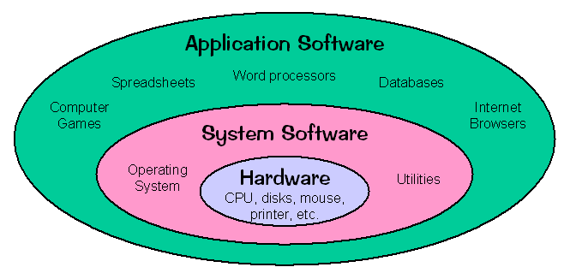
Introduction

Slide 16
Structure of Computer system
Computer system can be divided into four components
Hardware – provides basic computing resources
CPU, memory, I/O devices
Operating system
Controls and coordinates use of hardware among various applications and users
Application programs – define the ways in which the system resources are used to solve the computing problems of the users
Word processors, web browsers, database systems, video games
Users
People, machines, other computers

Slide 17
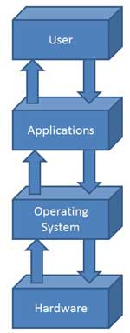
Structure of Computer system

Slide 18
Characteristics/Functions of an OS
Memory Management − Keeps track of the primary memory, i.e. what part of it is in use by whom, what part is not in use, etc. and allocates the memory when a process or program requests it.
Processor Management − Allocates the processor (CPU) to a process and de-allocates the processor when it is no longer required.
Device Management − Keeps track of all the devices. This is also called I/O controller that decides which process gets the device, when, and for how much time.
File Management − Allocates and de-allocates the resources and decides who gets the resources.

Slide 19
Characteristics/Functions of an OS
Security − Prevents unauthorized access to programs and data by means of passwords and other similar techniques.
Job Accounting − Keeps track of time and resources used by various jobs and/or users.
Control Over System Performance − Records delays between the request for a service and fulfilment from the system.
Interaction with the Operators − Interaction may take place via the console of the computer in the form of instructions.
The Operating System acknowledges the same, does the corresponding action, and informs the operation by a display screen.

Slide 20
Characteristics/Functions of an OS
Error-detecting Aids − Production of dumps, traces, error messages, and other debugging and error-detecting methods.
Coordination Between Other Software and Users − Coordination and assignment of compilers, interpreters, assemblers, and other software to the various users of the computer systems.

Slide 21
Introduction
The most important type of system software is the operating system. An operating system has three main responsibilities:
Perform basic tasks, such as recognizing input from the keyboard, sending output to the display screen, keeping track of files and directories on the disk, and controlling peripheral devices such as disk drives and printers.
Ensure that different programs and users running at the same time do not interfere with each other.

Slide 22
Introduction
Provide a software platform on top of which other programs (i.e., application software) can run.
The software that contains the core components of the operating system is called the kernel.
the operating system is a "black box" between the applications and the hardware they run on that ensures the proper result, given appropriate inputs..

Slide 23
Introduction
Operating systems are primarily resource managers —they manage
hardware, including processors, memory, input/output devices and communication devices.
They must also manage applications and other software abstractions that, unlike hardware, are not physical objects
Basic functions
1. Resource Management 2. Memory Management 3. Process Management

Slide 24
History and Classification
Operating systems have evolved over last 60 years. In the 1940s the early electronic computers did not have an operating System
Machines of that time were very primitive and programmers entered their machine code one bit at a time on mechanical switches.
Eventually, programmers entered their machine-language programs on punched cards.
Then, assembly languages—which used English-like abbreviations to represent the basic operations of the computer— were developed to speed the programming process.

Slide 25
History and Classification
General Motors Research Laboratories implemented the first operating system in the early 1950s for its IBM 701 computer.
The systems of the 1950s generally executed only one job at a time
Jobs typically executed without user input for minutes, hours or days.
These early computers were called batch processing systems, because programs and data were submitted in groups or batches by loading them consecutively onto tape or disk.

Slide 26
History and Classification
Batch Processing involves reading a series of jobs (called a batch) into the machine and then executing the programs for each job in the batch.
This approach does not allow users to interact with programs while they operate.
Drawbacks of Batch Processing
Although operating systems of the 1950s reduced inter job transition times, programmers often were required to directly control system resources such as memory and input/output devices. This was slow, difficult and tedious work.

Slide 27
History and Classification
These early systems required that an entire program be loaded into memory for the program to run.
This limited programmers to creating small programs with limited capabilities.
The systems of the 1960s were also batch-processing systems, but they used the computer's resources more efficiently by running several jobs at once.
The systems of the 1960s improved resource utilization by allowing one job to use the processor while other jobs used peripheral devices.
In fact, running a mixture of diverse jobs—some jobs that mainly used the processor (called processor bound jobs or compute-bound jobs)

Slide 28
History and Classification
and some jobs mainly use peripheral devices called I/O bound jobs is the best way To optimize resource utilization.
With this in mind the operating systems were designed with multiprogramming capabilities.
A system’s degree of multiprogramming is number of programs /jobs it can manage at once. Thus the OS evolved from managing one job to several jobs at once.
But the user’s still had to submit their jobs on punch cards, tapes or disks and could not interact with their jobs

Slide 29
History and Classification
In the late 60’s More advanced operating systems were developed to service multiple interactive users at once. Interactive users communicate with their jobs during execution
Because the user was present and interacting with it, the computer system needed to respond quickly to user requests; otherwise, user productivity could suffer.

Slide 30
History and Classification
Hence the concept of Timesharing systems was developed to support simultaneous interactive users.
This strategy supports multiple interactive users. Rather than preparing a job for execution ahead of time, users establish an interactive session with the computer and then provide commands, programs and data as they are needed during the session.
Most of the Timesharing Systems were multimode that is they supported both Batch processing and Real Time Systems

Slide 31
History and Classification
Real time systems attempt to supply a solution/response within a bounded time.
The concept of a Process was introduced now where a Process is a Program in execution.
Interactive computers reduced the Turn Around Time-which is the time between submission of a job and results —was reduced to minutes or even seconds.
The programmer no longer needed to wait hours or days to correct even the simplest errors. The programmer could enter a program, compile it, receive a list of syntax errors, correct them immediately, recompile and continue this cycle until the program was free of syntax errors.

Slide 32
History and Classification
In the 1970s. Communications between computer systems throughout the United States increased as the Department of Defence's TCP/IP communications standards became widely used.
During the 1970s, operating systems grew to encompass networking and security capabilities and continued to improve in performance to meet commercial demands.
The 1980s was the decade of the personal computer and the workstation

Slide 33
History and Classification
Emphasis was on GUI based Operating systems like Windows, Machintosh OS and Apple OS.
Concept of Distributed Computing and client server architecture became popular
In the 1990 with the Evolution Of WWW demand for Internet connections grew, operating system support for networking tasks became standard.
Users at home and in organizations increased productivity by accessing the resources on networks of computers

Slide 34
History and Classification
In the current era Operating systems are standardizing user and Application Interfaces so that they are easier to use and support greater number of programs.
Open source Operating systems such as LINUX have become more widely used and employ standard APIs.
Computing on mobile devices such as cell phones and PDAs will become more popular due to large processor speeds of mobile devices

Slide 35
TYPES OF OPERATING SYSTEM
Batch operating system
Multi-programmed operating system
Timesharing operating system
Network operating system
Distributed operating system
Real-time operating system
Multi-processor operating system

Slide 36
Types of OS
1. Batch Operating System –
The operating system is termed as “batch operating” because the input data (job) are collected into batches or sets of records with similar needs and each batch is processed as a unit(group). The output is another batch that can be reused for computation.
This type of operating system do not allow user to interact with the computer directly.
There is an operator which takes similar jobs having same requirement and group them into batches.
It is the responsibility of operator to sort the jobs with similar needs.

Slide 37
Types of OS
Disadvantages: 1. It is very difficult to debug batch systems. 2. Lack of interaction between user and operating system. 3. Suppose an error occurs in one of the jobs of a batch. Then, all the remaining jobs get affected i.e; they have to wait until the error is resolved.
Advantages:
1. Suppose a job takes a very long time(1 day or so). Then, such processes can be performed even in the absence of humans. 2. They don’t require any special hardware and system support to input data.

Slide 38
Types of OS
2. Time-Sharing Operating Systems – Each task is given some time to execute, so that all the tasks work smoothly. Each user gets time of CPU and feel as if they are using single system.
These systems are also known as Multitasking Systems. The task can be from single user or from different users also.
The time that each task gets to execute is called quantum. After this time interval is over OS switches over to next task.

Slide 39
Types of OS
Advantages of Time-Sharing OS:
Each task gets an equal opportunity
CPU idle time can be reduced
Disadvantages of Time-Sharing OS:
Reliability problem
One must have to take care of security and integrity of user programs and data
Examples of Time-Sharing OSs are: Multics, Unix etc.

Slide 40
Types of OS
Distributed OS
These types of operating system is a recent advancement in the world of computer technology.
Various autonomous interconnected computers communicate with each other using a shared communication network.
Independent systems possess their own memory unit and CPU. These are referred as loosely coupled systems or distributed systems.

Slide 41
Types of OS
The major benefit of working with these types of operating system is that it is always possible that one user can access the files or software which are not actually present on his system but on some other system connected within this network i.e., remote access is enabled within the devices connected in that network.

Slide 42
Types of OS
Advantages of Distributed Operating System
Failure of one will not affect the other network communication, as all systems are independent from each other
Since resources are being shared, computation is highly fast and durable
Load on host computer reduces
These systems are easily scalable as many systems can be easily added to the network
Delay in data processing reduces

Slide 43
Types of OS
Disadvantages of Distributed Operating System:
Failure of the main network will stop the entire communication
To establish distributed systems the language which are used are not well defined yet
These types of systems are not readily available as they are very expensive.
Examples of Distributed Operating System are- LOCUS etc.

Slide 44
Types of OS
Network Operating System – These systems runs on a server and provides the capability to manage data, users, groups, security, applications, and other networking functions.
These type of operating systems allows shared access of files, printers, security, applications, and other networking functions over a small private network.
One more important aspect of Network Operating Systems is that all the users are well aware of the underlying configuration, of all other users within the network, their individual connections etc. and that’s why these computers are popularly known as tightly coupled systems.

Slide 45
Types of OS
Advantages of Network Operating System:
Highly stable centralized servers
Security concerns are handled through servers
New technologies and hardware up-gradation are easily integrated to the system
Server access are possible remotely from different locations and types of systems
Disadvantages of Network Operating System:
Servers are costly
User has to depend on central location for most operations
Maintenance and updates are required regularly

Slide 46
Types of OS
Examples of Networked OS:
Microsoft Windows Server 2003, Microsoft Windows Server 2008, UNIX, Linux, Mac OS X, Novell NetWare, and BSD etc.
Real-Time Operating System – In These types of Oss the time interval required to process and respond to inputs is very small. This time interval is called response time.
Real-time systems are used when the time requirements are very strict like missile systems, air traffic control systems, robots etc.

Slide 47
Types of OS
Advantages of RTOS:
Maximum Consumption: Maximum utilization of devices and system, thus more output from all the resources
Task Shifting: Time assigned for shifting tasks in these systems are very less.
Error Free: These types of systems are error free.
Memory Allocation: Memory allocation is best managed in these type of systems.

Slide 48
Types of OS
Disadvantages of RTOS:
Use heavy system resources which are expensive as well.
Complex Algorithms: The algorithms are very complex and difficult for the designer to write.
Device driver and interrupt signals: It needs specific device drivers and interrupt signals.
Egs: Scientific experiments, medical imaging systems, industrial control systems, weapon systems, robots, air traffic control systems,

Slide 49
Types of OS
Multiprocessor Operating System refers to the use of two or more central processing units (CPU) within a single computer system. These multiple CPUs are in a close communication sharing the computer bus, memory and other peripheral devices. These systems are referred as tightly coupled systems.
These types of systems are used when very high speed is required to process a large volume of data. These systems are generally used in environment like satellite control, weather forecasting etc.

Slide 50
Types of OS
The advantages of the multiprocessing system are:
Increased Throughput − By increasing the number of processors, more work can be completed in a unit time.
Cost Saving − Parallel system shares the memory, buses, peripherals etc. Multiprocessor system thus saves money as compared to multiple single systems. Also, if a number of programs are to operate on the same data, it is cheaper to store that data on one single disk and shared by all processors instead of using many copies of the same data.
Increased Reliability − In this system, as the workload is distributed among several processors which results in increased reliability.
If one processor fails then its failure may slightly slow down the speed of the system but system will work smoothly.

Slide 51
Types of OS
Disadvantages of Multiprocessor systems
1.complex OS is required.
2.large main memory required.
3.very expensive.

Slide 52
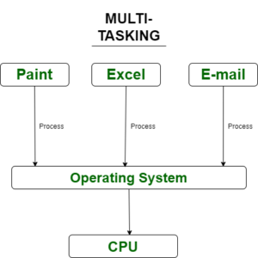
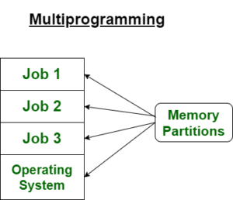
Multiprogramming vs Multitasking

Slide 53
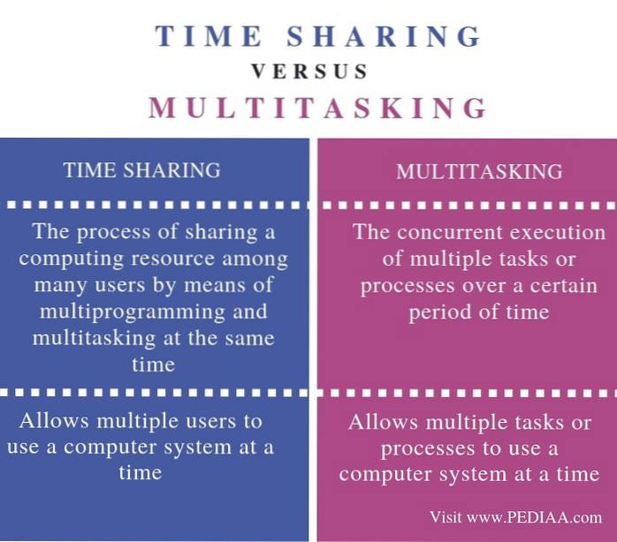

Slide 54
Review Questions
Define an OS
Describe the functions of an OS
What are the 4 components of a Computer system
Name the different types of OS

